Slide 1

FRAUD DETECTION MODEL FOR INSURANCE CLAIMS

Slide 2
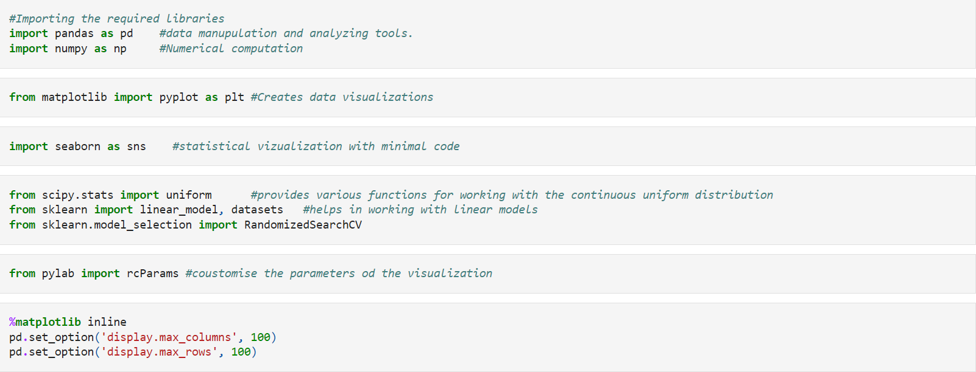
IMPORTING THE REQUIRED LIBRARIES

Slide 3
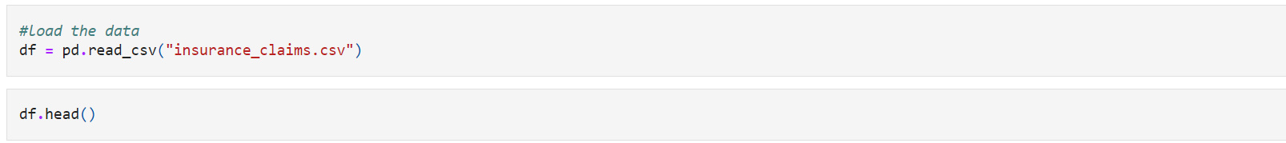
IMPORTING THE DATASET

Slide 4
DATA DICTONARY
months_as_customer- Number of months the customer is in relation with the insurance company.
Age-Age of the policy holder.
policy_number-Policy number of the customer.
policy_bind_date-The date on which policy is issued to the customer
policy_state-State of the policy holder
policy_csl- CSL is an insurance policy limit that covers bodily injury and property damage claims in a single maximum amount, regardless of their type [200/500]
policy_deductable- Policy deductible in insurance is the amount you pay out of pocket before your insurance coverage begins
Policy_annual_ premium-Policy annual premium is the total cost of insurance coverage for one year, paid in installments. Factors such as coverage type, level, deductible, risk profile, and underwriting policies determine the premium
umbrella_limit-An umbrella limit is a type of insurance policy that provides additional coverage above and beyond the limits of an individual's primary insurance policies
insured_zip-Zip code of the customer.
insured_sex-Gender of the policy holder.
insured_education_level-Education level of the policy holder.
insured_occupation-Occupation of the policy holder.
insured_hobbies-Hobbies of the policy holder
insured_relationship-The relationship between the policy holder and the insured person or property.

Slide 5
DATA DICTONARY
capital-gains- Insurance policies may offer investment options, such as whole life insurance policies or variable annuities, which can generate capital gains if the underlying investments appreciate in value. In such cases, the capital gains may be subject to taxation, and it is important to consult with tax professionals for guidance on tax implications.
Capital-loss-When insurance offer investment options, like full life insurance, the company might suffer a loss due to providing extra aminities.
incident_date-The date on which the incident took place.
incident_type-Type of automobile accident.
collision_type- Type of collision during the automobile accident.
incident_severity-If the incident is serious or not.
authorities_contacted- If police were informed about the incident
incident_hour_of_the_day-On which hour of the day the incident took place
Total-claim-amount-Total claim amount is the total amount of money that an insurance policyholder is entitled to receive from their insurance company for a covered loss.
Injury_claim-The amount the policy holder is entitled to receive to claim for the injury he faced.
property_claim-Injury-claim-The amount the policy holder is entitled to receive to claim for the damaged the property had.
vehicle_claim-Injury-claim-The amount the policy holder is entitled to receive to claim for the damaged on the vehicle.
fraud_reported- If fraud is reported or not.

Slide 6
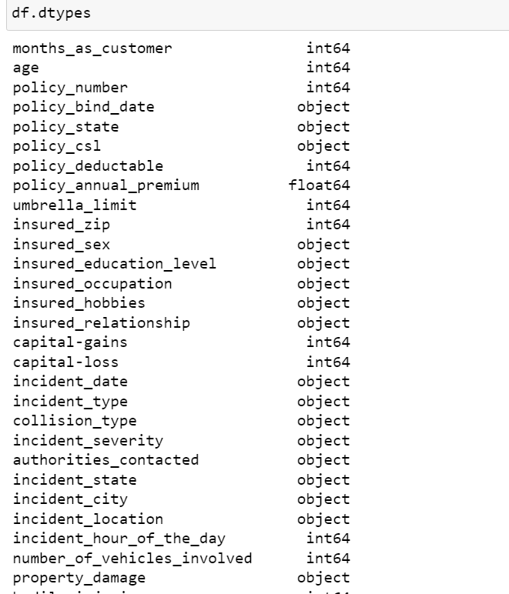
DATA TYPES OF THE COLUMNS.
Helps us understand if a column is numerical or categorical and makes the data exploration and pipelining easy

Slide 7
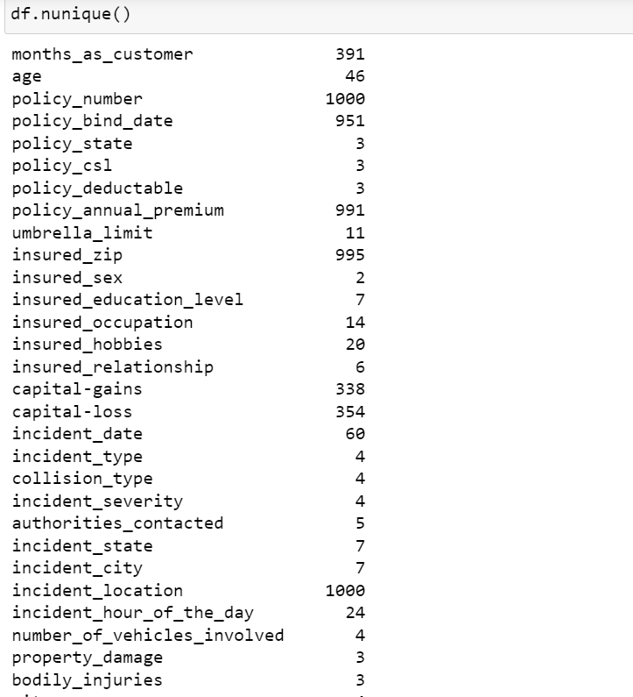
UNIQUE VALUES OF THE COLUMNS
FINDING UNIQUE COLUMS HELPS A LOT IN DATA EXPLORATION:
It is easier to find null values.
It also helps in data validation if there are any duplicate values present or not

Slide 8
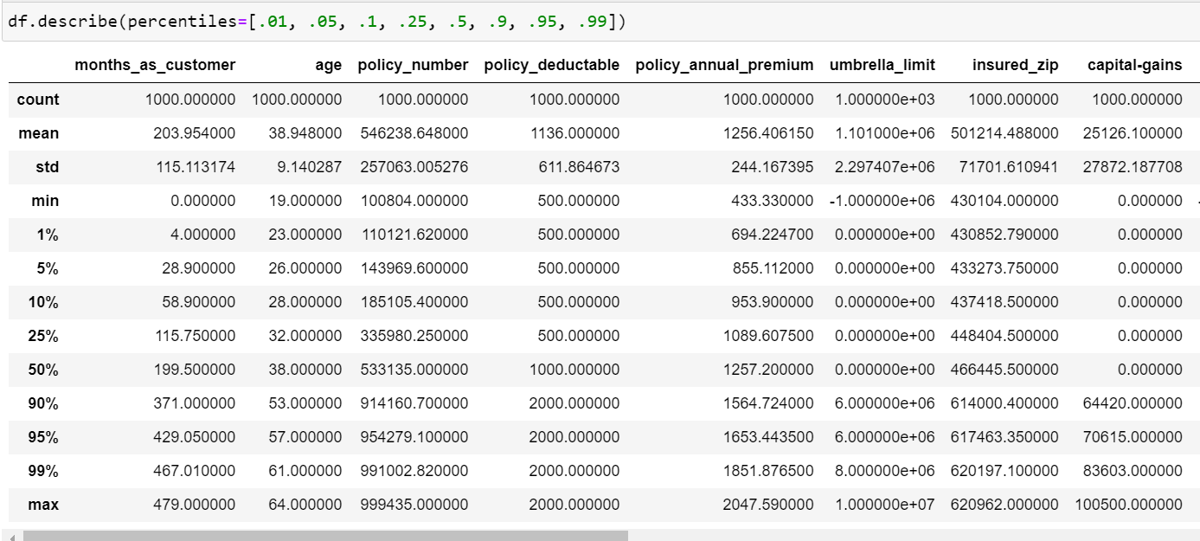
Describe the data frame
descibes the given data frame by providing count, mean,standard deviation and other parameters which helps us understand the data better and check how we can pre process a model for a specific task.

Slide 9
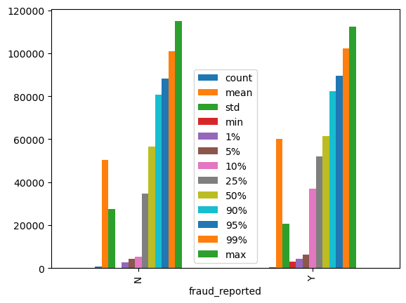
PICTORIAL REPRESENTATION
Grouping the fraud reported with respect to total_claim_amount-
From this we can identify that count of fraud reported with total claim amount is almost similar.
Maximum value for the fraud reported with respect to total claim is also similar .Fraud too place irrespective of the claim amount being high or low.

Slide 10
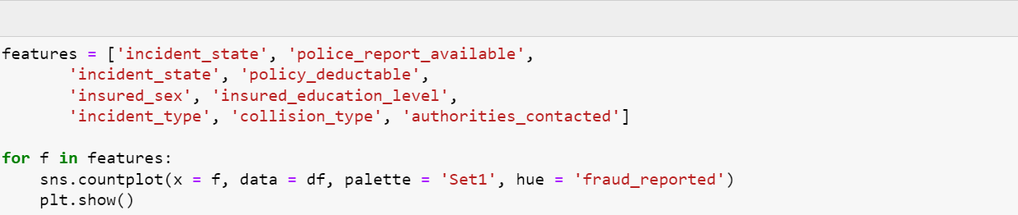

Slide 11
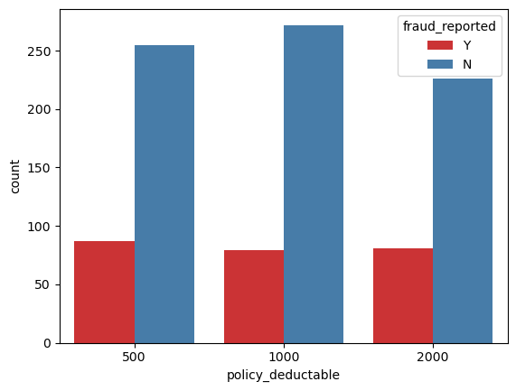
A simple visualization of “fraud_reported” with respect to policy_deductable which varies between ‘500’,’1000’ and ‘2000’.

Slide 12
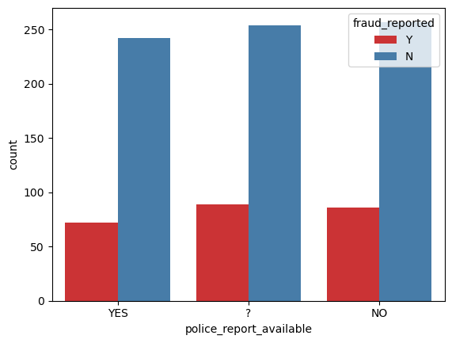
A simple visualization of “fraud_reported” with respect to “police_report_available which varies ‘YES’ ,’NO’ and whether the report was filed or not(?)

Slide 13
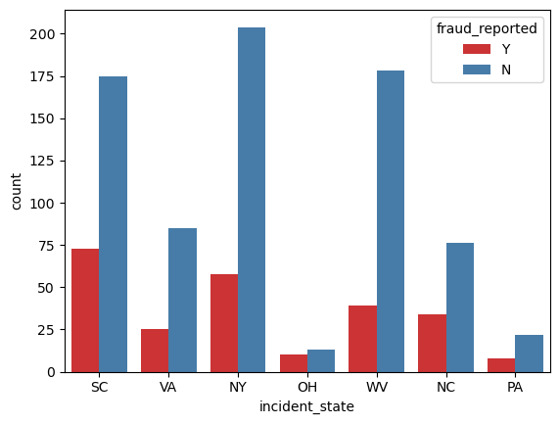
A simple visualization of “fraud_reported” with respect to “incident_state”which are as follows:
SC- South Carolina
VA-Virginia
NY-New york
OH-Ohio
WV-West Virginia
NC-North Carolina
PA-Pennsylvania

Slide 14
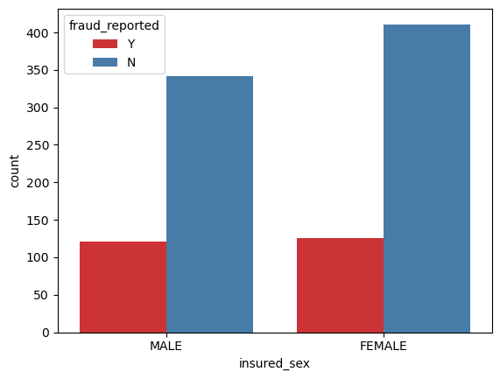
A simple visualization of “fraud_reported” with respect to “insured_sex.

Slide 15
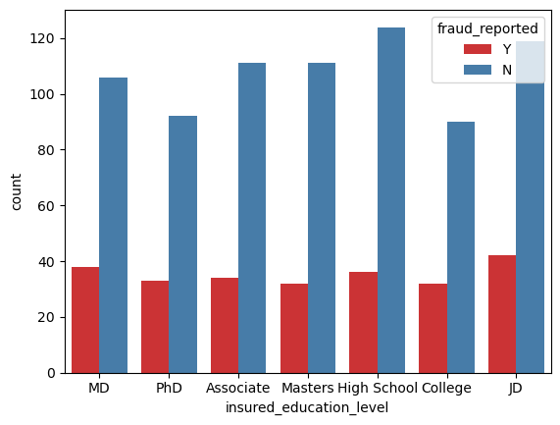
A simple visualization of “fraud_reported” with respect to insured_educational_level which are as follows:
MD- Doctor of Medicine
PHD-Doctor of philosophy
Associate-(junior college)
Masters degree
High school
College
JD- (undergraduate degree to become a lawyer.

Slide 16
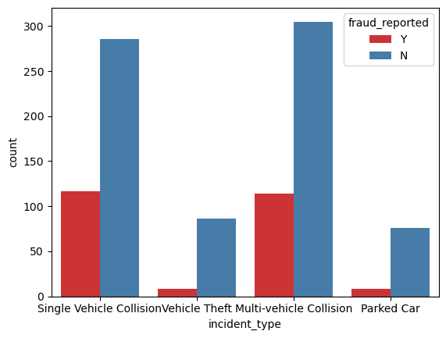
A simple visualization of “fraud_reported” with respect to “incident type”which is as follows:
Single vehicle collision
Vehicle theft
Multi-vehicle collision
Parked car

Slide 17
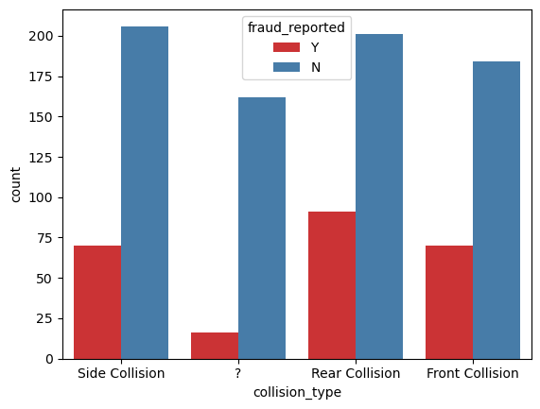
A simple visualization of “fraud_reported” with respect to “collision_type” which is as follows:
Side collision
Unknown(?)
Rear collision
Front collision

Slide 18
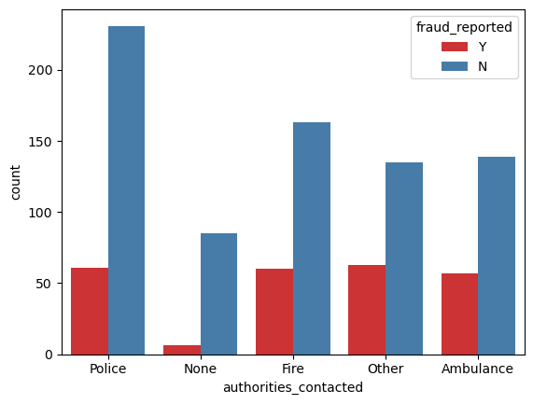
A simple visualization of “fraud_reported” with respect to “authorities_contacted” which are as follows:
Police
None
Fire
Other
Ambulance

Slide 19
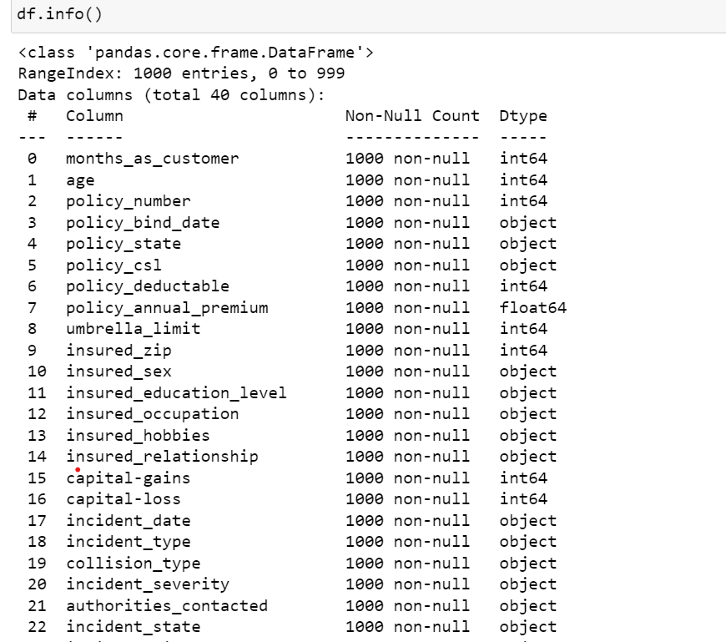
Information about the dataframe
This output shows that the DataFrame has 1000 rows and 40 columns, and it provides information about the data types of each columns
There are no null values in the dataset which makes data exploration easy

Slide 20
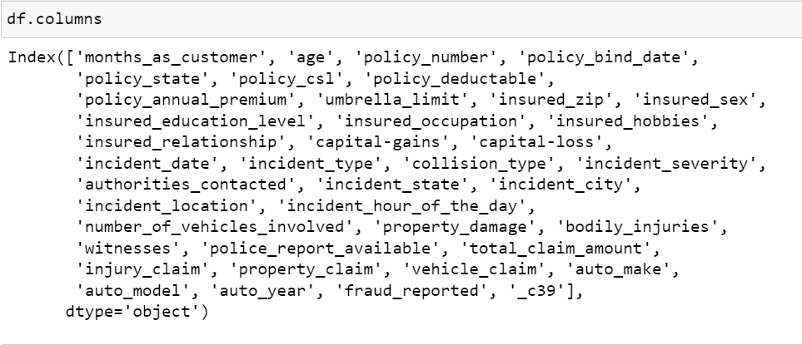
Retrieving the columns of the dataset

Slide 21

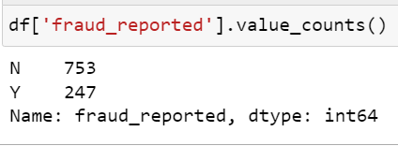
To count the value of fraud reported
Fraud_reported
The dataset consists of 1000 enteries of defining the information in the column likely refers to incidents of fraud that have been reported or identified.

Slide 22
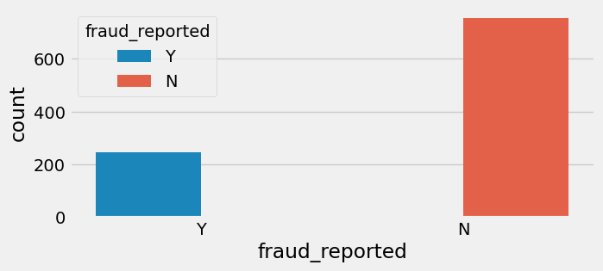
PICTORIAL REPRESENTATION
A simple visualization of the count of fraud reported and not reported in a dataset, using a bar plot with a custom style.

Slide 23
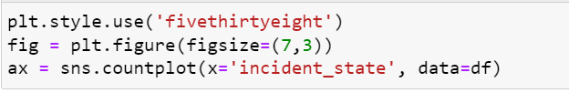
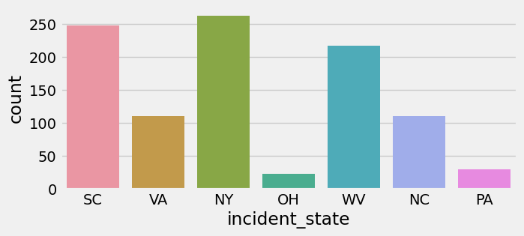
PICTORIAL REPRESENTATION
A simple plot using Seaborn library in Python to visualize the number of incidents that occurred in each state.

Slide 24
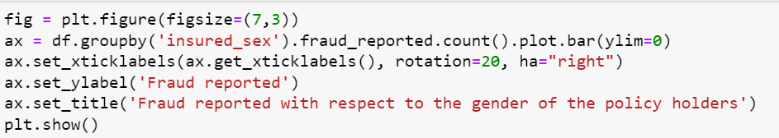
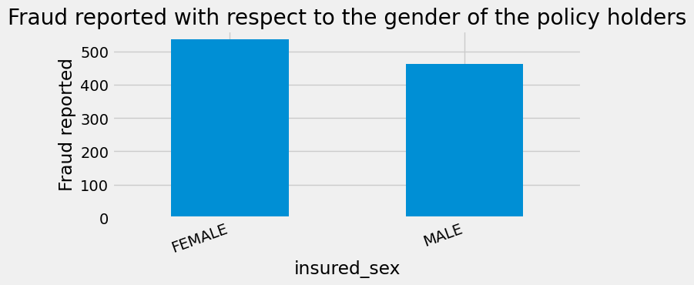
PICTORIAL REPRESENTATION
A simple visualization of the count of fraud reported with respect to the gender of policy holders, which can be useful for identifying any gender-based patterns in fraud incidents.

Slide 25
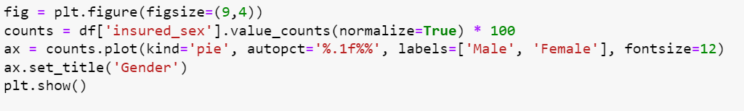
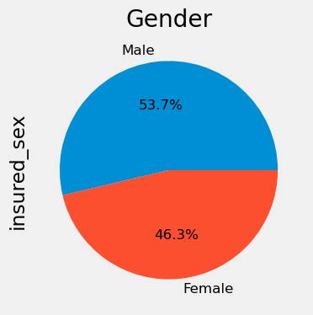
PICTORIAL REPRESENTATION
A simple visualization of the proportion of male and female policy holders in the dataset, which can be useful for understanding the gender distribution of policy holders.

Slide 26
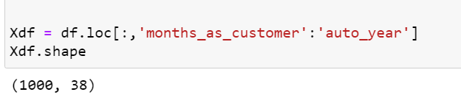

Creating new variables for further evaluation
Creates a subset of columns from “df” which results in Xdf containing all rows from df, but only the columns starting from 'months_as_customer' and ending with 'auto_year'
Creating a new variable named Ydf containing values of “fraud_reported “column where :
‘Y’ is replaced with ‘1’
‘N’ is replaced with ‘0’

Slide 27

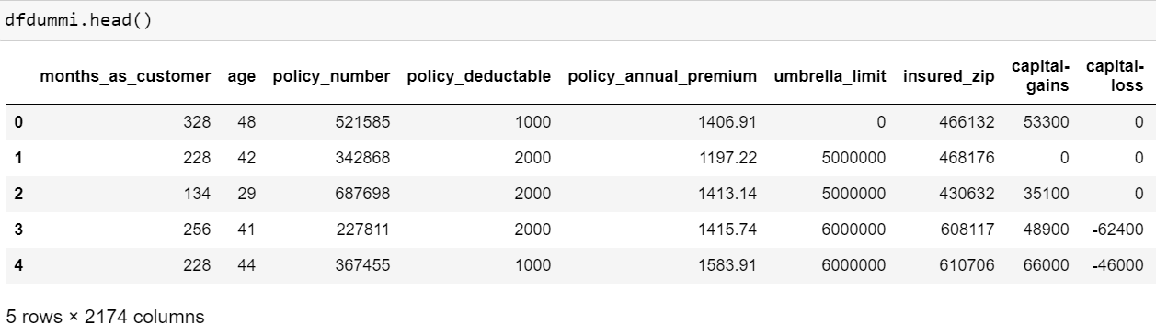


Creating dummi values
Why do we have extra columns in the dummi’s?
In the creation of dummies we use one-hot encoding which converts categorical variables into a binary matrix, where each category is a separate column and each row has a 1 or 0 indicating the presence or absence of that category.

Slide 28
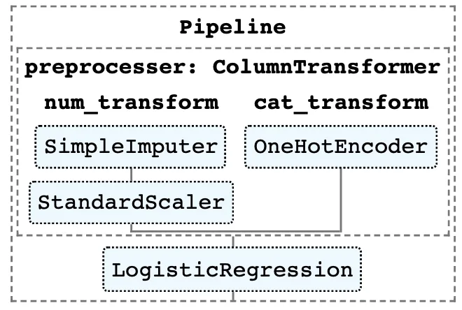
In case we had null columns we would use this method to fill up the null values.
In the instance pipeline, there is a preprocessor step of type Column Transformer that contains two sub-pipelines:
num transform is a numeric column sub-pipeline that fills null values and converts the column to a standard distribution.
cat transform is another sub-pipeline for categorical columns that performs one-time encoding.

Slide 29
Fraud reported is a binary classification problem
LOGISTIC REGRESSION: It is a statistical method for analyzing a dataset in which there are one or more independent variables that determine an outcome. It is used for binary classification problems, where the target variable can take only two values, such as "yes" or "no".
RANDOM FOREST: It is a supervised learning algorithm that can be used for both classification and regression tasks. It uses many decision trees to make predictions. It combines these trees in a clever way to make better predictions and avoid mistakes. This helps to reduce overfitting and improve the accuracy and robustness of the model.

Slide 30


To ignore un necessary warnings.

Slide 31
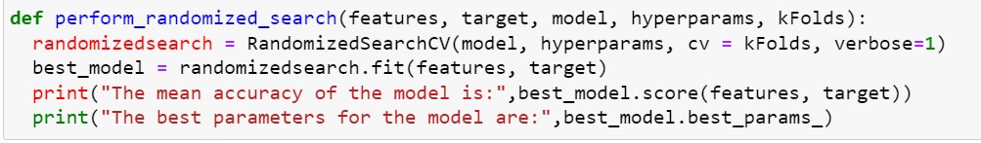
The above given block code performs a randomized search on the 4 given functions namely :
Features-The feature variables are independent variables to be used for model training and testing pandas Data Frame or NumPy array containing the feature variables.
Target- A Pandas Data Frame or NumPy array containing the target variable to be predicted by the model.
Model- The machine learning model to be trained and tested.
Hyperparameters-In machine learning, "hyperparameters" are model parameters that are set before training the model and cannot be learned from the data. They are often set manually, and can have a large impact on the performance of the model.
kFolds -In ML, "cross-validation" assesses model performance on limited data by splitting it into multiple subsets."kFolds" is the integer representing the number of subsets (or "folds") used in cross-validation.

Slide 32
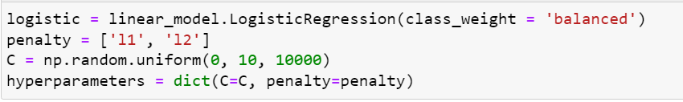
The code is creating a logistic regression model with balanced class weights to account for imbalanced class distributions using scikit-learn.The code generates a list of regularization penalties (L1 and L2) and a set of 10,000 random values for the regularization strength parameter (C) to tune the model.

Slide 33
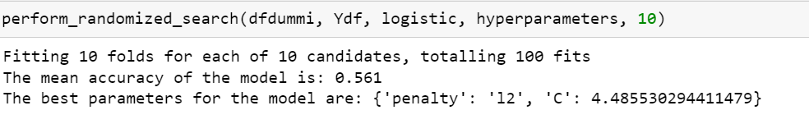
Performing a randomized search for the following parameter and verifying the best parameters required for the model .
The process involves testing 10 different combinations of hyperparameters and evaluating the performance of each combination using 10-fold cross-validation. This results in a total of 100 fits of the model.

Slide 34
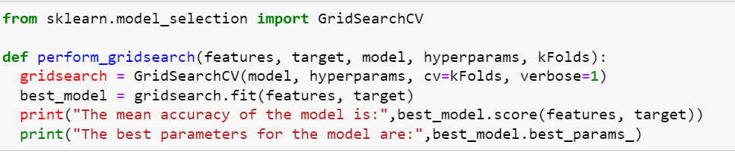
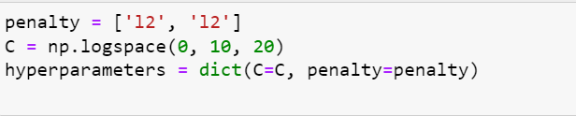
The code creates a list of two L2 regularization penalties and a set of 20 logarithmically spaced values for the regularization strength parameter (C) to be used in a grid search to find the optimal hyperparameters for a model. These hyperparameters are stored in a dictionary called hyperparameters.
Smaller C = stronger regularization=Less overfitting
Larger C = weaker regularization=More overlifting

Slide 35
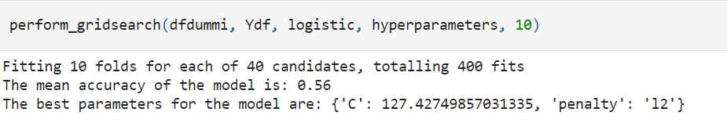
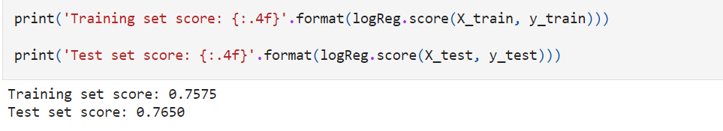
The first line prints the accuracy score of the model on the training data.
The second line prints the accuracy score of the model on the testing data.

Slide 36
The training-set accuracy score is 0.7575 while the test-set accuracy to be 0.76750. These two values are quite comparable. So, there is no question of overfitting.
In Logistic Regression, we use default value of C = 1. It provides good performance with approximately 75% accuracy on both the training and the test set. But the model performance on both the training and test set are very comparable. It is likely the case of underfitting.
It will increase C and fit a more flexible model.
Overfitting: Overfitting in logistic regression refers to a situation where the model is too complex and has learned the noise in the training data, resulting in poor performance on new, unseen data.

Slide 37
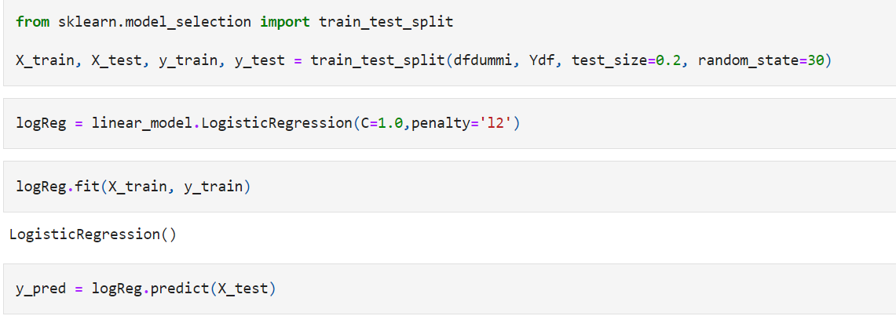
Training and Testing
Training and testing via logistic regression is done

Slide 38
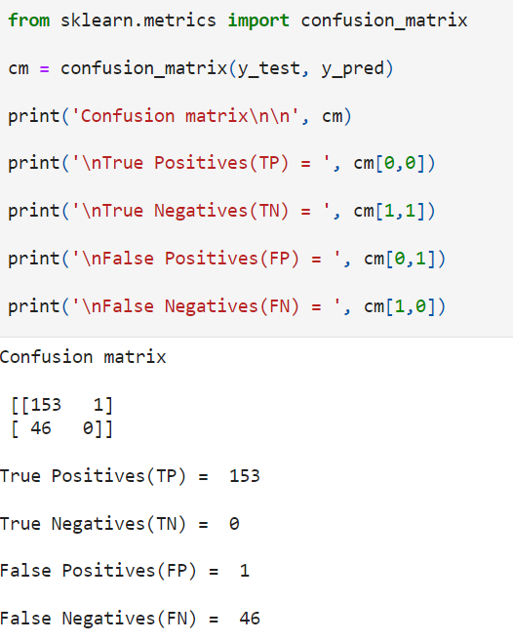
Confusion matrix
A confusion matrix can help evaluate the accuracy of the classification model, by looking at the following metrics:
True Positive (TP): the number of correctly predicted positive samples
False Positive (FP): the number of incorrectly predicted positive samples
True Negative (TN): the number of correctly predicted negative samples
False Negative (FN): the number of incorrectly predicted negative samples
From these metrics, we can derive other evaluation metrics such as precision, recall, and F1-score.

Slide 39
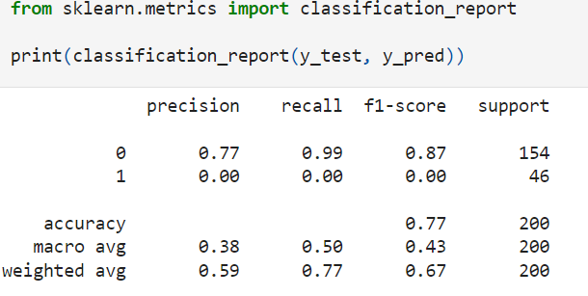
Classification report of the model.
Accuracy-Tells us how often our classifier is right
Precision – Tells us how often is the positive value right.
Recall- How often can the model predict the correct positive values.
F1- score : How many times can you take precession and recall under consideration
Precision: TP / (TP + FP) measures the accuracy of the positive predictions.
Recall: TP / (TP + FN) measures the ability of the classifier to correctly identify the positive samples.
F1-score: 2 * (precision * recall) / (precision + recall) is the harmonic mean of precision and recall.
Macro-average Recall = (Recall1 + Recall2 + ... + RecallN) / N
Accuracy = (TP + TN) / (TP + TN + FP + FN)
Weighted-average Recall = (Recall1 * Support1 + Recall2 * Support2 + ... + RecallN * SupportN) / Total Support
Support= total number of instances in that class

Slide 40
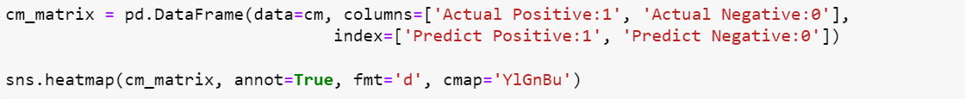
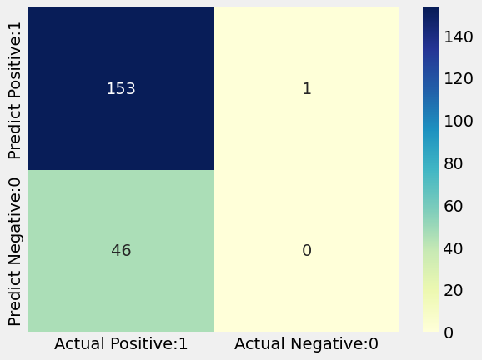
Visualization of the confusion matrix.

Slide 41
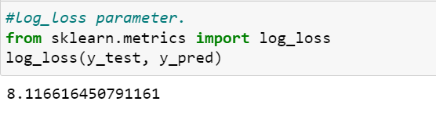
LOG LOSS
It measures the difference between the predicted probability distribution of the model and the true probability distribution of the actual data.
The log loss value ranges between 0 and infinity, where a lower value indicates better performance of the model. A perfect model would have a log loss of 0, meaning that it correctly predicts the class of every instance in the dataset.

Slide 42
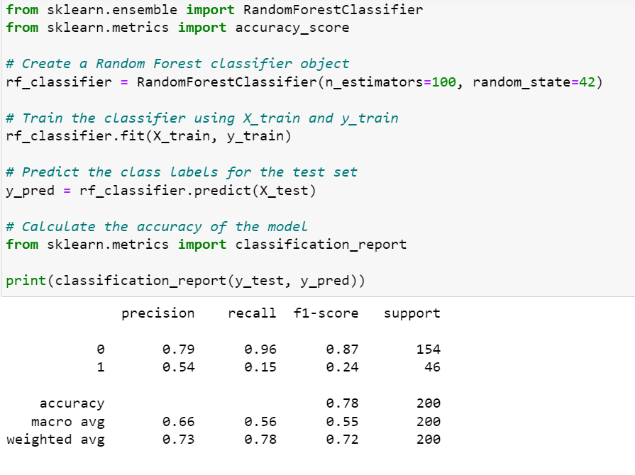
Random forest
Accuracy-Tells us how often our classifier is right
Precision – Tells us how often is the positive value right.
Recall- How often can the model predict the correct positive values.
F1- score : How many times can you take precession and recall under consideration

Slide 43
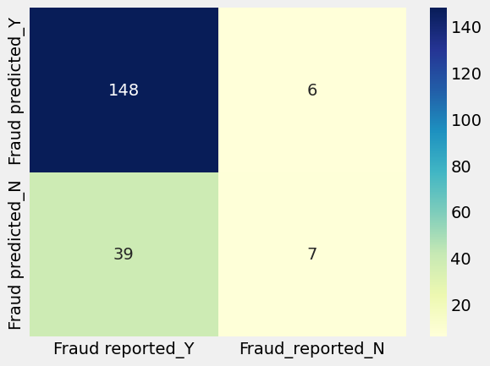
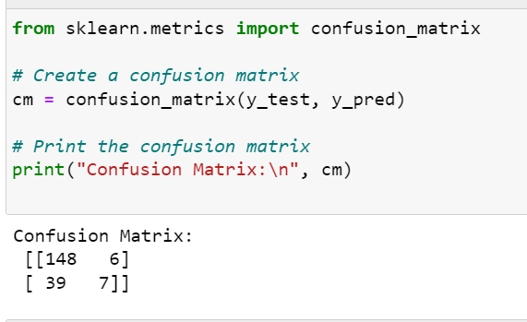
Random forest confusion matrix
In matrix form
Data visualization

Slide 44
Confusion Matrix:
Random forest tends to have a higher true positive rate and true negative rate, and a lower false positive rate and false negative rate compared to logistic regression. This means that random forest is better at identifying both positive and negative cases correctly, while making fewer mistakes in terms of misclassifying positive cases as negative, and vice versa.
Accuracy:
Random forest tends to have higher accuracy than logistic regression, especially when dealing with complex datasets with many features and non-linear relationships between the features and the target variable.

